Slide 1
WordPress A-Z
By: Subrata Deb Nath
CEO, Sbtechbd Technolgy
email.: subrata6630@gmail.com
Facebook: fb.com/subrata6630

Slide 2
Why WordPress?
Easy to customize, Easy Admin Dashboard
17% of the total websites in the world is running WordPress

Slide 3
WordPress Development Scopes
Theme Development
Plugin Development
Widget Developement

Slide 4
WordPress Theme Development
File Strutures:
Styles.css
Index.php
Functions.php

Slide 5
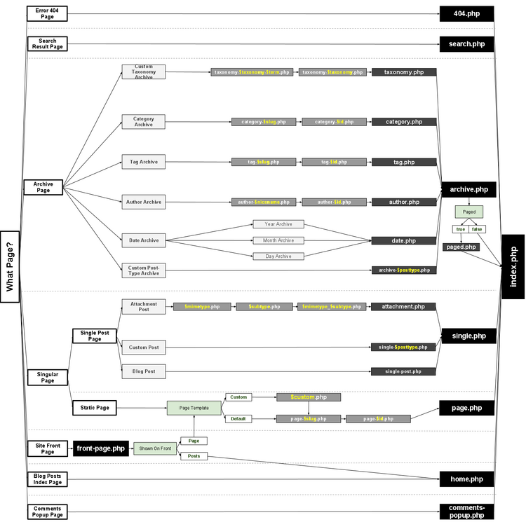
Template Hierarchy

Slide 6
Menu Bar Creation
So easy in WordPress
<?php wp_nav_menu( $args ); ?>

Slide 7
Custom Page Template
Page-{page-slug}.php
<?php /* Template Name: My Custom Page */ ?>

Slide 8
Widgetizing Your Theme
<?php register_sidebars( $number, $args ); ?>
<?php dynamic_sidebar( 'right-sidebar' ); ?>

Slide 9
Custom Post Types
Opportunities to create posts beyond 10 default types

Slide 10
Meta Boxes
Custom input box Areas
- post metaboxes
-page metaboxes
https://github.com/bainternet/My-Meta-Box

Slide 11
Translation
Poedit
.POT, .po, .mo files

Slide 12
Best Pactrice for WP theming
WP_debug
Themecheck
Semantic Html5 Markups
Minified css, js file
Use files in cdn sources

Slide 13
Tips for Better WordPress sites
Caching
Ofloading

Slide 14
Thank You
Thanks to all!

